Slide 1
Voices of Decision-Makers
How District & School Leaders Decide about
School Librarian Employment
International Association of School Librarians Virtual Conference: October 26, 2024

Slide 2
Agenda
About SLIDE
Findings of the “Voices” interview phase
Factors that influenced decisions about employment
Interactions of school leaders with librarians
SLIDE website and data tools
Q&A about “Voices” findings

Slide 3
About SLIDE
SLIDE
The School Librarian Investigation:
Decline or Evolution?
The SLIDE project was made possible in part by an
Institute of Museum and Library Services
Laura Bush 21st Century Librarian Grant RE-246368-OLS-20.
The School Librarian Investigation:
Divergence & Evolution
The SLIDE project continues with the support of the
School of Information at San Jose State University.

Slide 4
Panelists
SLIDE Project Director:
Debra E. Kachel
SLIDE Principal Investigator:
Keith Curry Lance, Ph.D.
SLIDE Volunteer:
Caitlin Gerrity
Affiliate Faculty, School of Education, School Library Media Endorsement Program, Antioch University Seattle
Assoc. Professor & Director, School Library Media Endorsement Program, Southern Utah University
Research Consultant,
San Jose State University

Slide 5
Major SLIDE Project Reports
Perspectives on School Librarian Employment
Quantitative: Determined trends over time in school library employment from the National Center for Education Statistics (NCES)
The COVID-19 Pandemic & Inequities in Access to School Librarians
A SLIDE Special Report on the impact of COVID-19 on school libraries and employment
Voices of Decision-Makers
Qualitative: Interview decision-makers in school districts that have reported the greatest librarian gains and losses over the past five years

Slide 6
Voices of Decision-Makers
https://libslide.org/voices-of-decision-makers/

Slide 7
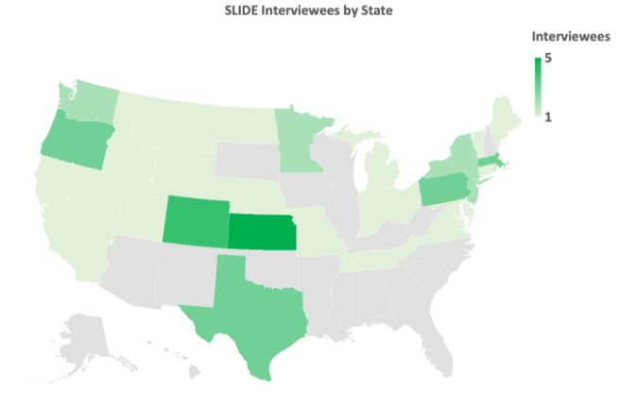
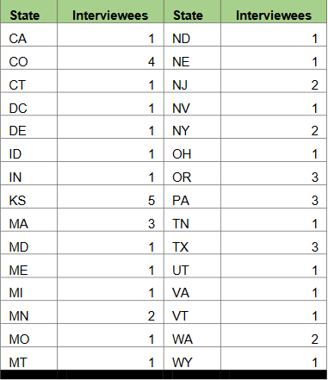
SLIDE Interviewees by State

Slide 8
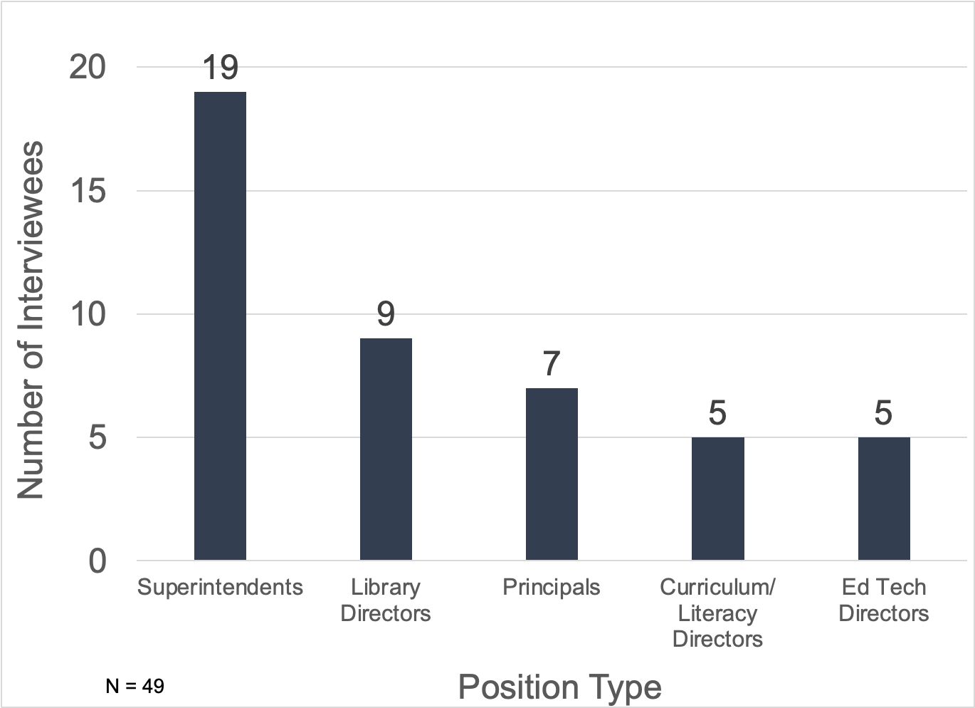
Interviewees by Position Type

Slide 9
Interviewees by Number & Type of Decision
49 Interviews (5 covering >1 decision)
54 decisions
28 decisions to add/restore librarians
26 decisions to reduce/eliminate librarians

Slide 10
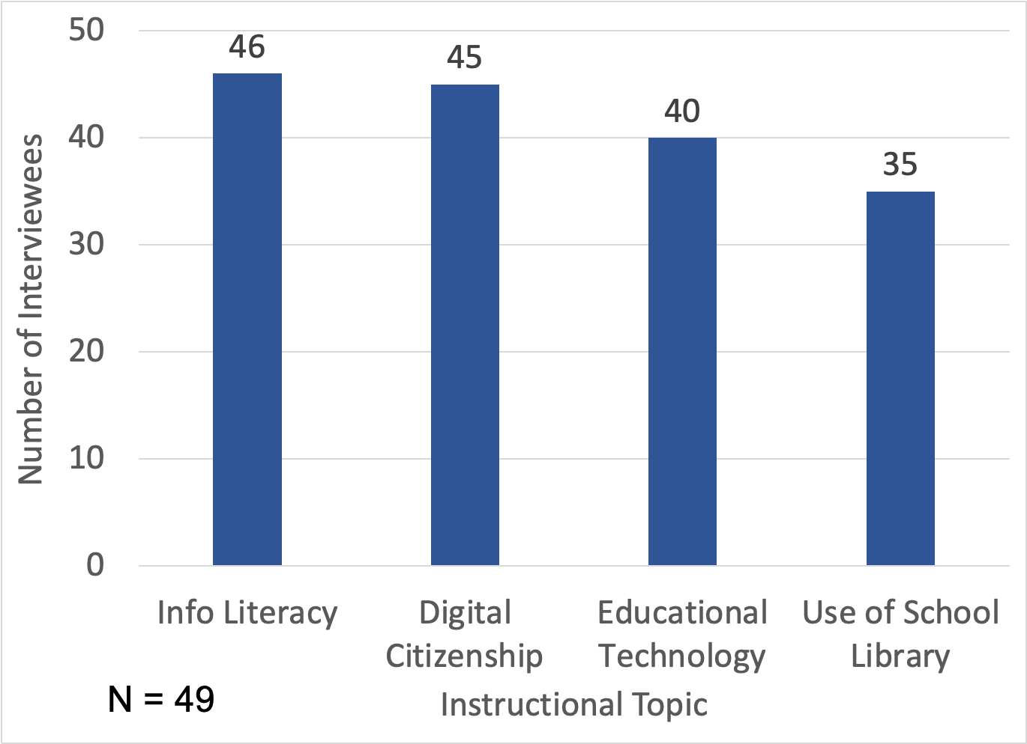
Topics Taught by Library / Info Resources Staff Reported by Interviewees

Slide 11
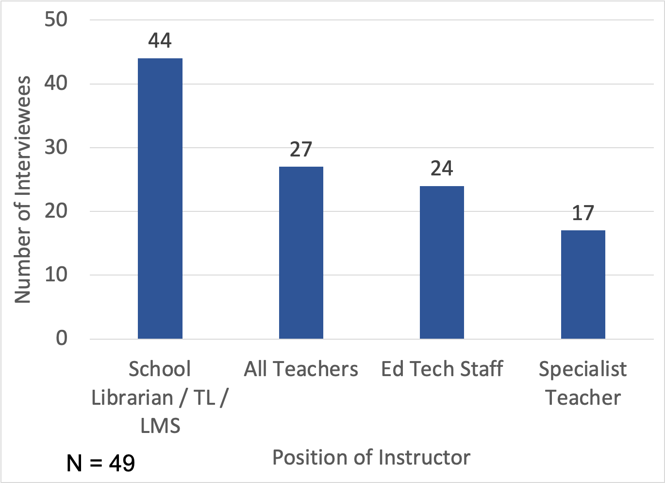
Instructor of Library / Info Resources Topic Reported by Interviewees

Slide 12
Instructional Topics by Instructor (Added/Restored)
Instructional Topics by Instructor (Reduced/Eliminated)

Slide 13
Factors in Decisions to Add/Restore Librarians
Structural / Pragmatic Factors | Strategic Factors
New funding | Change in priorities/administration
Opened a new building | Stand-alone instruction by librarians
State government mandate | Equity of student access to librarians
Grant/funding requirements | Collaboration with teachers
Planning time for teachers | Standards-based testing

Slide 14
Quotes from Interviewees: Strategic Factors in Decisions to Add / Restore Librarians
Librarians worked with teachers to develop the digital citizenship curriculum; so the increase in staffing didn’t happen because of the library, it happened because of technology.
Use of the library was transformed. Before, staff checked things in and out and did read alouds. Now, there is a librarian to teach digital literacy and research techniques as well as integrate information resources with content areas.
Assessment is a key piece because when you’re trying to get approval for more positions, you have to have a compelling argument. “This helps critical thinking skills” isn’t enough; it has to be “some of our students don’t have any of these skills.”

Slide 15
Factors in Decisions to Reduce, Eliminate, Combine or Reclassify Librarians
Structural / Pragmatic Factors | Strategic Factors
Budget constraints | Change in priorities
Closed a building/enrollment decrease | Change in administration
Needed more teachers in classroom | Position deemed obsolete
Pipeline issues finding candidates | Hired other specialists / coaches

Slide 16
Quotes from Interviewees: Strategic Factors in Decisions to Eliminate Librarians
Unfortunately, if I have to make a decision between library and math or language arts, those are tested areas. That’s why I had to cut a librarian position.
One of our elementary schools did not have a STEM teacher, and given that we’re a 1:1 district now, that was seen as a higher priority than keeping a librarian.
The district kept kindergarten a full-day program—rather than cutting it to half-day—instead of restoring librarian positions. When more funds became available, a STEM teacher was hired rather than a librarian.

Slide 17
Positive Interactions of Interviewees as Administrators with Librarians
There was a book on one of our reading lists that some parents thought controversial. Our librarian was integral to the conversations about how you choose a book with your child, and why these books are published. Kids need to see themselves in different types of literature. Her expertise needed to be there. Your library becomes a living place instead of a book repository because of that person.
I just completed a unit observation with the library media specialist, watching our 2nd grade students get excited about coding. Only 7 or 8 years old, they learned terms like algorithm! Whatever the topic, the library media specialist is elevating student learning, helping them learn concepts that are going to help them in math, science and other classes. I think it’s a huge success.
A principal in a school I was working with started to realize that the media specialist wasn’t just an extra resource for teachers and students, but also an extra resource for the principal. The principal realized that the media specialist was truly a leader in that building— someone who talked regularly with and influenced all of its teachers.

Slide 18
Positive Interactions of Interviewees as Teachers with Librarians
My librarian and I usually partnered on teaching research assignments, each teaching different things…She also made sure that we had access to needed books. Anytime I noticed kids struggling, I’d say “Hey, can you help me with this?” And I knew she would.
I marvel at our librarian’s ability to shift from the needs of one student or group of students to another. One minute, a group of students needs help starting the research process; the next minute, it’s an individual wanting help finding detailed information about bio-medical research…When I see so many kids in a library, I know we have the right person in that job; they are being a resource, a support system those kids truly need.
When I started teaching, it was the certified high school librarian who convinced me that it’s our role to create opportunities to close the literacy gap. She really opened my eyes.

Slide 19
Negative Interactions of Interviewees as Administrators with Librarians
I’ve seen good librarians and bad ones. The ones that don’t do a good job leave a bad taste in people’s mouths. When administrators and teachers have bad experiences with folks like that, it can influence their perceptions for a long time.
The librarians were really difficult to manage and supervise. The personality and style of the librarian has a lot to do with the level of support within the building for that individual. We had a librarian in an elementary school who was a pain to deal with. The rest of the staff were worn out by it. Teachers delivered students to the library and left…The personality of the individual in this position is critical.
When I was a principal, I had a paraprofessional who acted as the librarian. She was always griping about how the kids left the library so messy. They were always messing up her books.

Slide 20
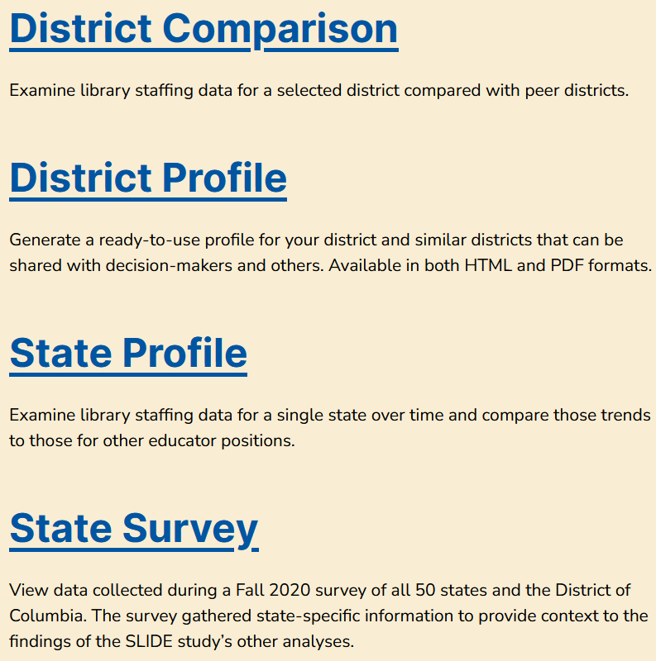
SLIDE Data Tools
https://libslide.org/data-tools/

Slide 21
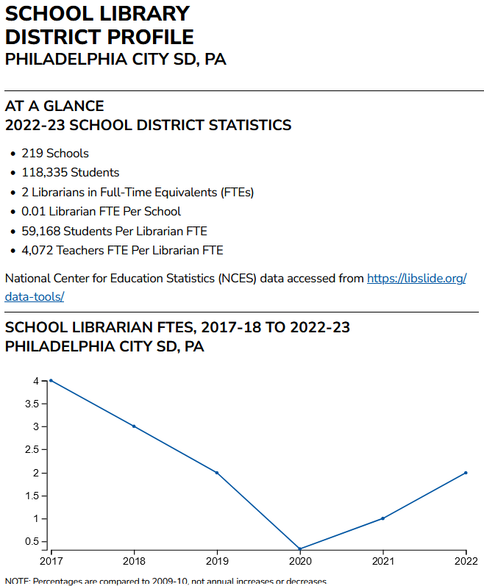
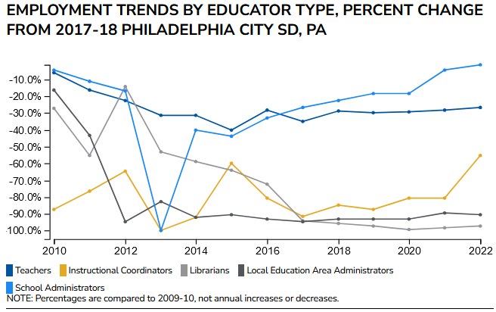
District profile
https://libslide.org/district-profiles/

Slide 22
Your Take on “Voices” Findings
Based on your experience, are there other major decision factors?
What might you do differently based on these findings?
How might these findings inform school library advocacy?
Notes:
Supply & demand (recruitment, training, & placement, geography & locale)
NCES data updates
1 librarian per school

Slide 23
Thank you
Questions?
dkachel@antioch.edu
keithlance@comcast.net

