Slide 1
Access to School Librarians: It’s an Equity Issue for Students
24 June 2023
Mary K. Biagini, University of Pittsburgh
Debra E. Kachel, Antioch University Seattle
American Library Association Conference 2023
Educators of School Librarians Section (ESLS)

Slide 2
Equity is key
Access to school librarians is an educational equity issue
Students and teachers who have access to school librarians have a decided advantage over those who do not—a library privilege that helps learners learn

Slide 3
What we know
Access to school librarians is
strongly related to student race and ethnicity
Access is further exacerbated for students living in:
Extreme poverty
More isolated locales
Smallest school districts where students are less likely to have access to educational resources available in larger districts
Hispanic-majority districts

Slide 4
School librarian losses are not universal
Since 2010, 10-15 states gained librarians, but 3-4 times that many states lost librarians
COVID impact: 2020-21 record low number of states gained and record high number of states lost
2021-22: record high number of gaining states and record low number of losing states

Slide 5
Access to school librarians varies by locale
Districts in suburbs & cities more likely to have librarians in all or most schools
Districts in rural areas and towns more likely to have no librarians in any schools
.75+ FTE per school: ratio SLIDE uses to determine if district has enough librarians to employ full-time librarian in all or most schools
(No data on Individual school librarian staffing)

Slide 6
Access to school librarians varies by student enrollment
Larger-enrollment districts are more likely to have librarians in all or most schools
Smaller-enrollment districts are more likely not to have librarians in any schools
Overall, fewer than 1 in 5 districts has enough librarians for most schools
1/3+ of districts have no librarians in any schools

Slide 7
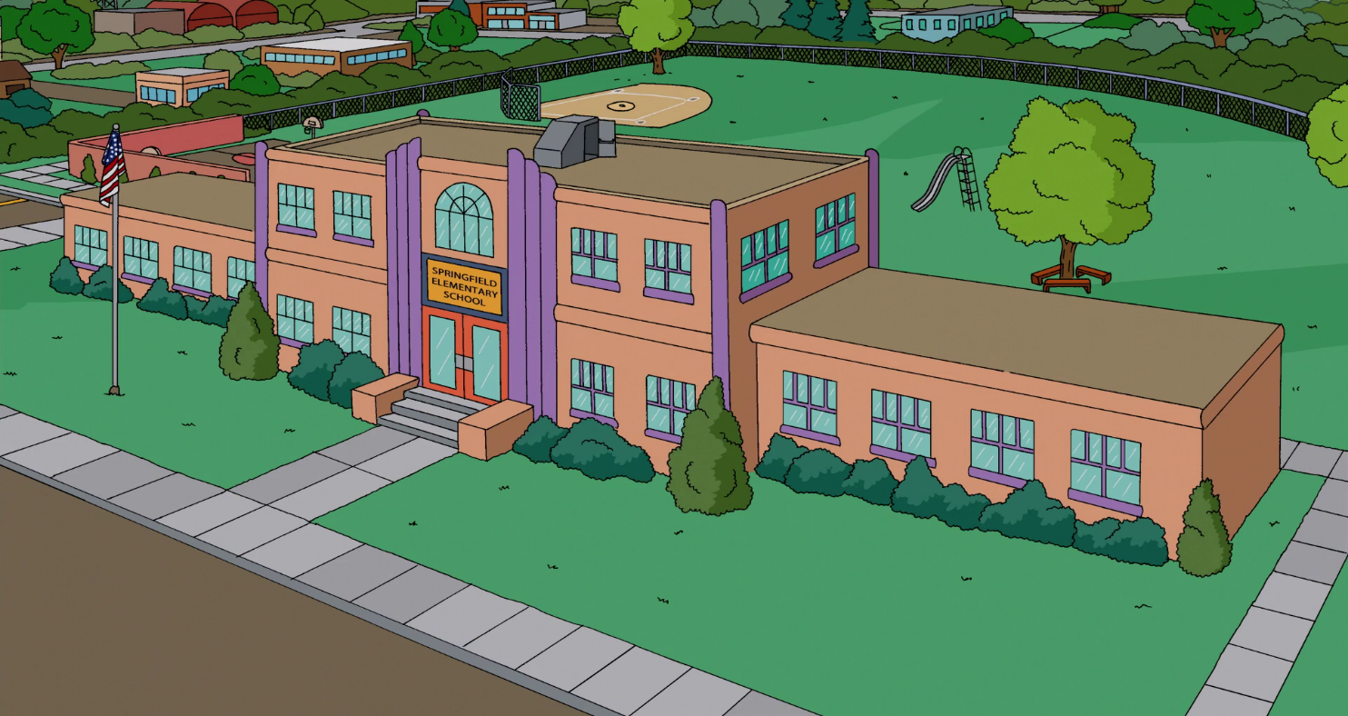
Small- Enrollment Schools Ratios
Almost 2.2 million students (4.8% of K-12 students) were enrolled in 2,049 districts (16.1% of all districts) that reported employing enough school librarians to have >500 students per librarian
Of these districts, 71.8% had fewer than 1,000 students in the entire district
This Photo by Unknown Author is licensed under CC BY-SA

Slide 8
Access to school librarians varies by student poverty status
Districts in wealthiest communities most likely to have librarians in all or most schools
Districts in poorer communities more likely not to have librarians in any schools

Slide 9
Race/Ethnicity
Impact of majority race often ameliorated by locale (city) and enrollment (higher):
Majority BIPOC districts are equally unlikely to have librarians in most schools and are slightly more likely not to have librarians in any schools
Majority Hispanic districts--mostly smaller and rural--
Fare dramatically worse than majority non-Hispanic districts
Half as likely to have librarians in most schools; far more likely not to have librarians in any schools

Slide 10
Student Demographics
How do student demographics relate to meeting the existing standard of having a full-time librarian in every school?
For majority minority districts (those where <50% of students are BIPOC), 8.2% of districts met the librarian-in-every-school standard compared with 11.3% of districts that were majority white
How do student demographics relate to meeting the hypothetical standard of >500 students for every school librarian?
For majority minority districts, 9.8% of districts met the standard of >500 students per librarian compared with 17.3% of districts that were majority white

Slide 11
What we know
Access to school librarians is correlated to state staffing requirements
Whether enforced or not, states with school librarian staffing requirements have more librarians than states without any requirements

Slide 12
YES, AND ENFORCED: 10 states plus DC (22%) have legal, enforced requirements for school librarians in their public schools: AL, AR, KY, MS, MT, NE, ND, OK, SC, WI, & District of Columbia
YES, BUT NOT ENFORCED: 16 states (31%) have legal requirements that are not enforced: CA, GA, IN, IA, LA, ME, MD, NH, NJ, NM, NY, OR, TN, VT, VA, WA
NO REQUIREMENT: 24 states (47%) have no legal requirements: AK, AZ, CO, CT, DE, FL, HI, ID, IL, KS, MA, MI, MN, MO, NV, NC, OH, PA, RI, SD, TX, UT, WV, WY
Kachel, D. E., & Lance, K. C. (2021, January 26).
Contexts for school librarian employment. https://libslide.org/pubs/contexts.pdf.

Slide 13
What we know
Based on 2021-22 NCES data:
There are not enough school librarians nationwide to provide a librarian per school building
There are not enough librarians for a librarian for every 500 students

Slide 14
One FTE librarian in each school
5.9 million students (12.9% of all K-12 students) are enrolled in 1,350 districts (10.6% of all districts) that reported enough school librarians to employ one full time librarian in every school
The average number of students per librarian for these 1,350 school districts was 561

Slide 15
Districts employing enough school librarians to have a librarian in each school 2021-22
And the only winner is . . . Arkansas!
In AR, 58.3% of districts employ enough school librarians to have 1 librarian per school
¼ to ½ of districts were comparably staffed in 9 states: SC, NH, CT, GA, AL, VT, VA, TN, & NJ
No districts in 10 states met this staffing: All students are without adequate access to school librarians in D.C., AK, DE, HI, ID, MN, NM, OR, SD, UT, & WV

Slide 16
Bottom Line: Lack of equity
20% of full-time-equivalent school librarians lost in last decade
Fewer than 40,000 school librarians nationwide
In 2021-22:
7.1 million students in districts without any librarians*
4 million students in majority nonwhite districts without any librarians (57% of the 7.1 million students in all districts without any librarians)
In 2021-22, almost 35% of all school districts had zero librarians*
Gap between students in districts with a “library privilege” and those without librarians continues to widen
* Does not include individual schools without librarians

Slide 17
The pipeline of new librarians is a trickle . . .
Teachers often pivot from the classroom to the library with little coursework or experience
Fewer programs educate school librarians—undergraduate or graduate

Slide 18
Institutions of Higher Education Preparing School Librarians
# Institutions | # States | States
8 | 1 | TX
6 | 3 | AL, NY, TN
5 | 2 | IL, NC
4 | 7 | CA, GA, KY, LA, MD, OK, WA
3 | 8 | AR, KS, MA, MN, MO, NJ, VA, WI
2 | 10 | CO, CT, FL, ID, IA, MT, NE, ND, PA, SD
1 | 15 | DC, DE, HI, IN, ME, MI, MS, NV, NH, OH, RI, SC, UT VT, WV
0 | 5 | AK, AZ, NM, OR, WY
29 |  | 2021 Totals
Source: Kachel, D. E., & Lance, K. C. (2021, January 26). Contexts for school librarian employment. https://libslide.org/pubs/contexts.pdf p.9-10.

Slide 19
What can we as educators do to improve the flow?
What’s
happening
in
your state?

Slide 20
Thank you!
Please check out the SLIDE website
Interactive data tools for accessing user-specified data at state & district levels (step-by-step tutorials included)
Custom Search
District Comparison
State Profile (including time-lapse map of districts)
State Survey
https://libslide.org

Slide 21
Contact Info
Deb Kachel dkachel@antioch.edu
Mary Kay Biagini biagini@pitt.edu

Slide 22
This project was made possible in part by the Institute of Museum and Library Services Laura Bush 21st Century Librarian Grant Project RE-246368-OLS-20. The views, findings, conclusions or recommendations expressed in this website and related products do not necessarily represent those of the Institute of Museum and Library Services.

