Slide 1
School Libraries
Link Students to Literacies:
What We Know Now
9 May 2023
Mary K. Biagini, PhD
University of Pittsburgh
Indiana Libraries and Literacies Symposium

Slide 2

Who are we?
Can we do a 27-second share?
Show of hands
School
Librarian
Public or Academic Librarian
Teacher
School Administrator
Parent
Community Member
Stakeholder
Decision
Maker

Slide 3
I come as a messenger
How do school librarians help students learn and build their literacies? Results from past state studies
What do we know now about school libraries and school librarians? SLIDE Study
What can we do to strengthen school libraries and assure that all students learn and become productive citizens? It’s up to us

Slide 4
SLIDE:
The School Librarian Investigation--Decline or Evolution?
Deb Kachel
SLIDE Project Director
Keith Curry Lance
SLIDE Principal Investigator

Slide 5
SLIDE Overview
Funding
  Institute of Museum and Library Services (IMLS) Laura Bush 21st Century Librarian grant program: Research in Service to Practice project
Purposes
  Examine national, state, and local district data to assess inequities in access to librarians by K–12 students in public schools
  Learn how and why school decision-makers chose staffing patterns to deliver library, information services, and instructional technology to their schools
How
  Analyzed NCES school librarian employment data at national, state, and district levels
  Analyzed state surveys providing context for school librarian employment
  Interviewed school decision-makers and examined job descriptions--both indicating the shifting or blending of roles and duties of school librarians

Slide 6
Source of data analyzed for SLIDE
SLIDE uses data collected from 13K+ local districts included in the Common Core of Data (CCD) Project of the National Center for Education Statistics (NCES)
https://nces.ed.gov/ccd/

Slide 7
School Libraries
&
Librarians
&
Literacies
How did we get to now?
What’s the status of school libraries nationally?
What’s the status of Indiana school libraries?
How can we shape a positive future for school libraries and for our students?

Slide 8

First— what is a school library?
Center of the school community
Safe place for students
Where students and faculty learn and achieve
Collaboration space for critical inquiry using reliable sources for learning and for life
Critical location for developing lifelong learners and readers

Slide 9

What do school librarians do?
Provide equitable access for all students to pursue academic and personal interests
Select and provide access to current, trustworthy, diverse resources
Collaborate with teachers to teach and assess information literacy competencies across the curriculum
Teach and model digital citizenship and media and computing literacy skills
Foster a love of reading
Create a welcoming, inclusive hub of learning for students and teachers
Offer teachers professional development

Slide 10
Our Context
To understand today we need to understand
how we got here

Slide 11
School Libraries are not a new concept--Ben Franklin realized their importance!
1740
Benjamin Franklin recommends a school library as a key element in the ideal academy
1744
Penn Charter School in Philadelphia designates a specially designed room as the library
1835
New York State enacts law to use tax funds to purchase library books
1901
Carnegie Library of Pittsburgh Training School is first program in U.S. to educate librarians to work with children
1900
Mary Kingsbury recognized as first professional school librarian at Brooklyn’s Erasmus High School

Slide 12
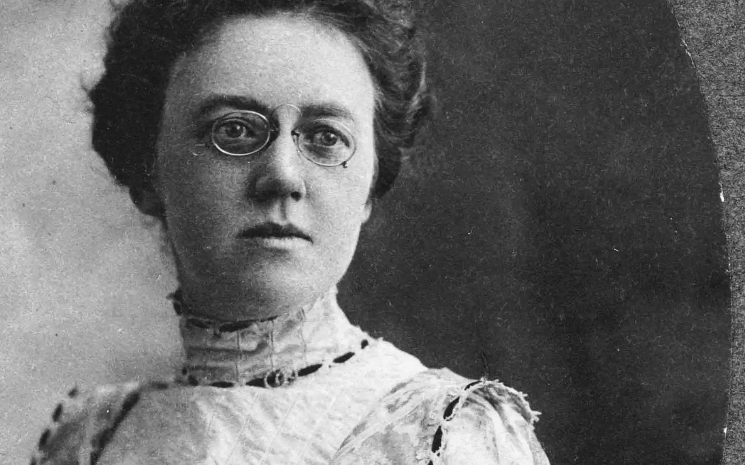
Mary Kingsbury, First professionally-trained school librarian--1900

Slide 13
Rise of school libraries:
Standards
Professional organizations
Federal funding
1876
826 school libraries
1913
10,000 school libraries
1896/1914
First professional organizations for school librarians: NEA and American Library Association
1900/1920
First standards for school libraries
1958
First federal funding for school libraries—National Defense Education Act (NDEA)

Slide 14
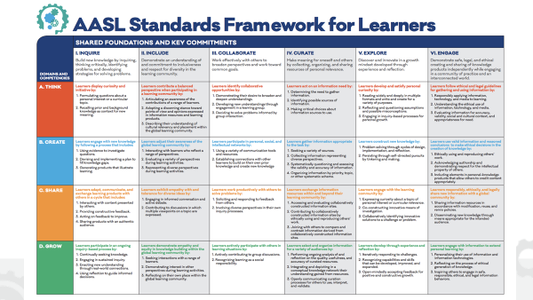
Latest Standards
AASL, 2017

Slide 15

Milestones with impact on school libraries
Federal Funding: NDEA, ESEA, Improving Literacy through School Libraries, E-Rate, ESSA, IMLS, LSCA/LSTA, American Rescue Plan Act
Standards: 1920, 1925, 1945 (first qualitative), 1960, 1969, 1975, 1988, 1998, 2007, 2017
Demonstration Libraries: 1963-74 Knapp School Library Project created model libraries

Slide 16
Some milestones are positive/Some aren’t
1979/2002: White House Conferences on Libraries
1982: Pico vs. Island Trees Supreme Court decision ruled in favor of First Amendment rights for students
1988: DeWitt Wallace-Reader’s Digest Fund: Library Power's collection development, flexible scheduling, and professional development contributes to new collaboratiions and practices in participating schools
1993: Supreme Court upholds Children’s Internet Protection Act
2023: ALA documents 1,269 demands in 2022 to censor library books--highest number of attempted book bans since ALA began compiling data 20+ years ago and nearly doubles the 729 challenges reported in 2021

Slide 17
How do school librarians help students learn and build their literacies?
What we know from state studies
Impact on learning: 22+ state studies document impact of certified school librarians on student achievement
Problem: Impact is little known by decision makers and key stakeholders so school librarians must advocate for their instructional role.
Result: When librarian positions are cut or in danger of being cut, often no local voices lead awareness efforts to sustain school librarians for students
SLIDE finding: when librarian positions were cut, only one position out of 10 were reinstated over 5-year span

Slide 18

Developing Literacies in students is a collaborative process partnering school librarians with teachers, administrators, and other librarians

Slide 19
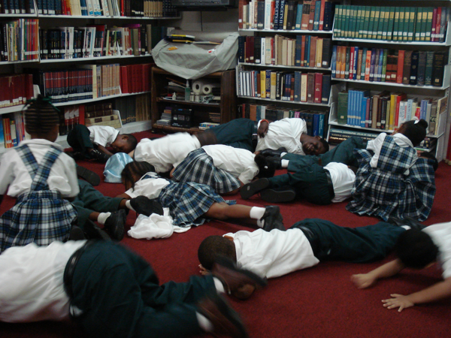

Print Literacy
Combat Illiteracy/Aliteracy
Librarians partner with
teachers to:
Develop life-long readers,
Help students read critically
Make reading fun!

Slide 20
Information
Literacy
Print
Visual
&
Media
Computing
& Technology
Cultural
Civic
Digital
School librarians
teach students multiple literacies

Slide 21

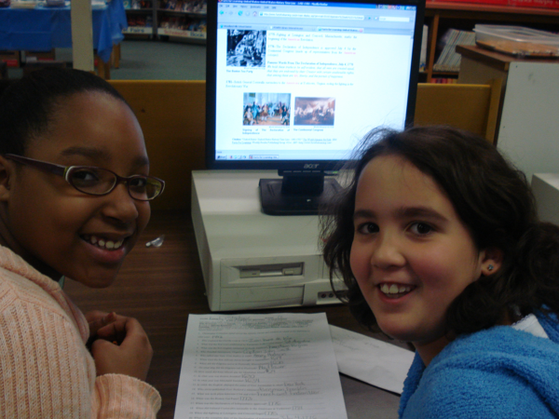
Librarians are more than “nice to have” in the budget
Administrators can misunderstand the teaching roles of librarians and fail to support librarians partnering and collaborating with teachers
When budgets are cut, the perception that librarians are “nice to have” but nonessential—performing mostly clerical work-- can lead to position cuts or reductions

Slide 22
Key components of effective school libraries
Funding for library resources annually
Full-time, certified librarian and support staff
Technology: Internet-accessible computers and access to digital resources and support infrastructure
Collection: Current trustworthy resources
Access by students to school library beyond school day and flexibility in elementary libraries
Teaching and assessing information literacy skills in collaboration with teachers

Slide 23
National Trends about School Librarians from
SLIDE
Here’s the evidence

Slide 24
SLIDE Finding: Why are there fewer school librarians?
With a nationwide literacy crisis, an epidemic of information illiteracy (“fake news”), and the demand for supporting students in hybrid and blended learning, there has been a 20 percent drop in the number of school librarian positions over the past ten years

Slide 25
Nationwide, number of school librarians has been declining for more than a decade:
In 2019-20, COVID accelerated that trend
. . . but losses slowed in 2020-21
2021-22 1st year in decade that number of school librarians increased: +186
Were some librarians temporarily reassigned?
Did some librarians prove their worth during pandemic?

Slide 26


What happened during the pandemic?
Many school librarians were assigned or reassigned to other job responsibilities or positions:
Testing coordination
Textbook and computing-device distribution
Substitute teaching
Tech support for online learning--sometimes outside the school day
These assigned tasks remove librarians from their most impactful roles as instructional partners and teachers

Slide 27
Administrator support is key to the school library’s success in student achievement
Receive little formal education on the roles and benefits of school librarians for students and teachers
Perceive “clerical” competencies” as primary role rather than instructional and impactful professional practices
Tend to ascribe success to personality and interpersonal skills rather than recognize
positive impact of a school librarian
Fail to consider factors within their control (fostering collaborative school culture, promoting library services, and encouraging librarians)
Key factors why administrators don’t always provide support

Slide 28


It’s all about equity for all students
School libraries bridge the gap between access and opportunity, providing students a safe space to explore personal interests and issues
School libraries are not immune to challenges to the very foundation of public education: equitable access and intellectual freedom

Slide 29

How are staffing decisions made?
SLIDE is 1st study to explore trends in school-library staffing decisions
Connection between school-librarian losses and race, ethnicity, poverty, locale, and enrollment of school & district posit that access to a qualified school librarian is an educational equity issue.
Are the responsibilities of “the traditional school librarian” being
  Delegated elsewhere?
  Evolving?
  Combining with other educator roles and taking on a different model entirely?

Slide 30

What decisions on positions got made?
SLIDE Interviewers conducted 50+ interviews of school leaders nationwide in districts that gained, lost some, or lost all librarians:
Decisions driven by structural, pragmatic & strategic considerations
Many factors affecting each situation & decision type
Evolving positions: combined jobs, restructured jobs, new positions and new position titles

Slide 31

What we know now
Access to school librarians is strongly related to student race and ethnicity
Access is further exacerbated for students living in:
  Extreme poverty
  More isolated locales
  Smallest school districts where students are less likely to have access to educational resources available in large districts

Slide 32
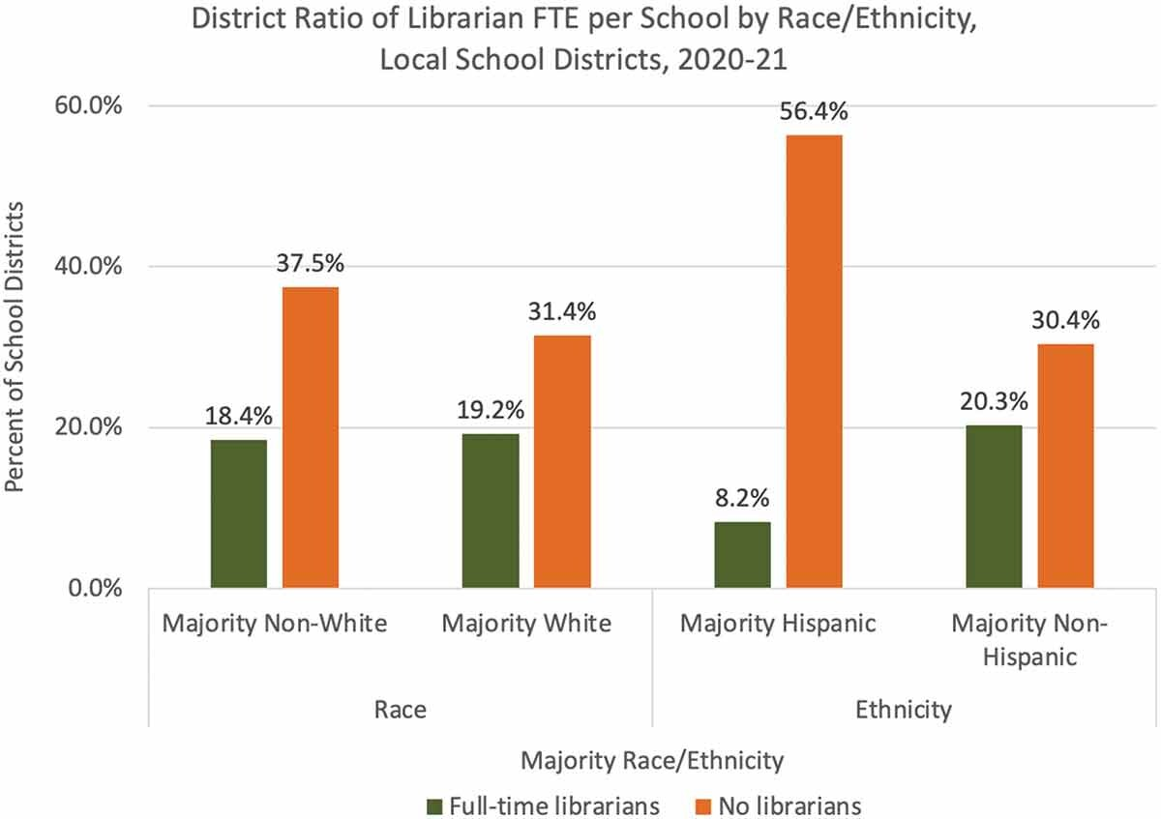

Slide 33

An equity issue for students and teachers
Students and teachers who have access to school librarians have a decided advantage over those who do not—a library privilege
Access to school librarians is an educational equity issue

Slide 34
School librarian losses not universal
Most years for more than a decade, 10-15 states gained librarians but 3-4 times that many states lost librarians
COVID impact: 2020-21 record low number of states gained and record high number of states lost.
2021-22 record high number of gaining states and record low number of losing states.
What next?

Slide 35
.75+ FTE per school is the ratio SLIDE uses to determine if a district has enough librarians to have a full-time librarian in all or most schools.
(Actual school staffing data on librarians are not available.)
Access to school librarians varies by locale
Districts in suburbs & cities more likely to have librarians in all or most schools
Districts in towns and rural areas more likely to have no librarians in any schools

Slide 36
Access to school librarians varies by student enrollment
Larger district are more likely to have librarians in all or most schools
Smaller districts are more likely not to have librarians in any schools
Overall, less than 1 in 5 districts has librarians in all or most schools, and more than 1/3 have no librarians in any schools

Slide 37
Access to school librarians varies by student poverty status
Districts in wealthiest communities most likely to have librarians in all or most schools
Districts in poorer communities more likely not to have librarians in any schools

Slide 38
Majority non-white districts are equally unlikely to have librarians in most schools and are slightly more likely not to have librarians in any schools
Impact of majority race often ameliorated by locale (city) and enrollment (higher)
Majority Hispanic districts mostly smaller and rural fare dramatically worse than majority non-Hispanic ones and are half as likely to have librarians in most schools, and far more likely not to have librarians in any schools.

Slide 39

Bottom Line: Lack of equity across the U.S.
20% of full-time equivalent school librarians lost in last decade
Fewer than 40,000 school librarians nationwide
Decline in the number of FTE school librarians between 2015 and 2020-21
In 2020-21, 3 million students in majority nonwhite districts were without any librarians
54% of the 5.6 million students in all districts did not have any librarians during the COVID-19 pandemic
Gap between students in districts with a “library privilege” and those without librarians continues to widen

Slide 40
Indiana Demographics
Students/Staff
Public Schools
Student Race/Ethnicity
Students
982,308
Teachers
62,980
Librarians
517
Library Support
1,107
1,769
(1920-21: 120 charter schools not included in SLIDE data)
White = 67%
Hispanic = 13%
Black = 11%
2 or More = 5%
Asian Pacific = 3%

Slide 41
Bottom Line Indiana
103 Indiana school districts have NO school librarians: 35% of all school districts (103/291)
Number of FTE Librarians fell from 692 in 2015-16 to 458 in 20-21: 34% fewer in 6 years
https://libslide.org/data-tools/state-profile/

Slide 42
Bottom Line Indiana
Number of students per librarian has risen 751 students in 6 years: 015-16: 1,512 2020-21: 2,263
Almost half of NO-librarian districts have libraries run by support staff.
In 2020-21, there were 517 Librarians and 1,107 Library Support staff

Slide 43
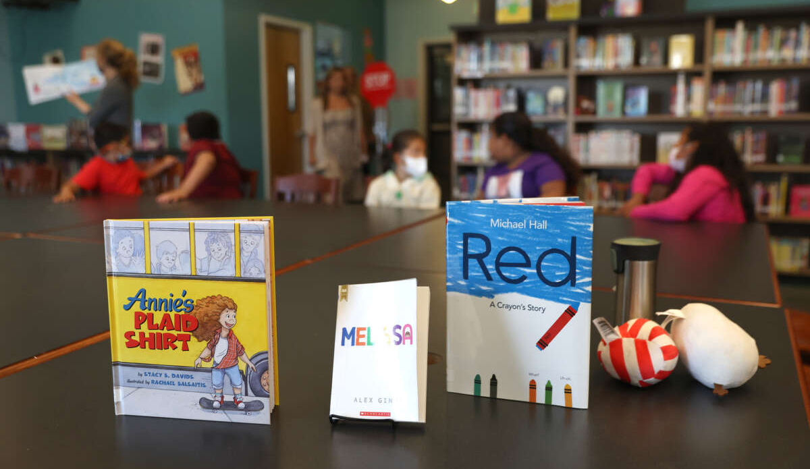
New Threat:
Massive Book Banning
Newly donated LGBTQ+ books are displayed in the library at Nystrom Elementary School on May 17, 2022, in Richmond, California. Justin Sullivan / Getty Images

Slide 44

How do librarians serve all students?
APNews.com

Slide 45
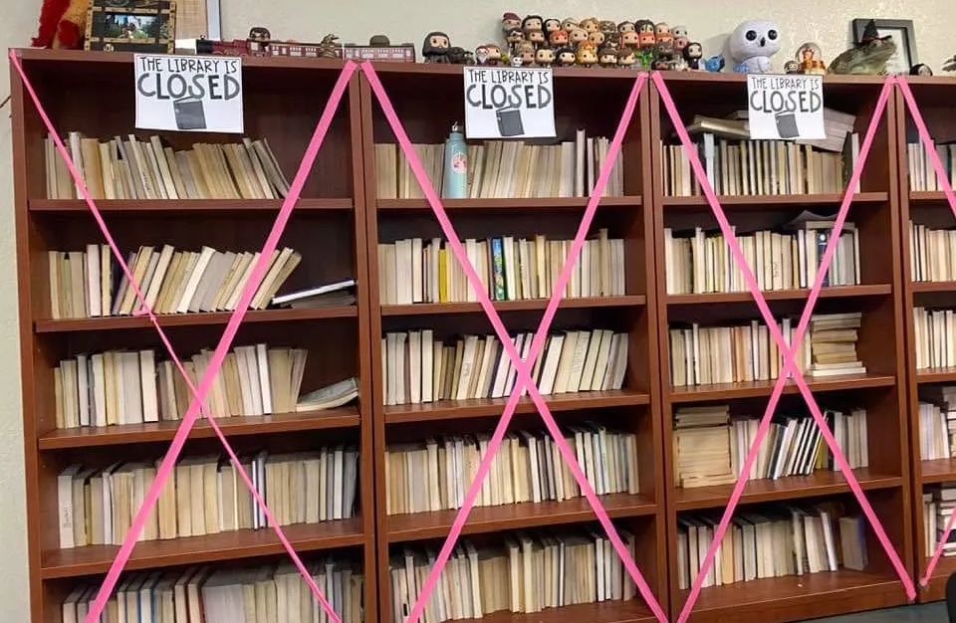
Some states eliminated classroom ollections
https://www.tcpalm.com/story/opinion/columnists/laurence-reisman/2022/09/16/pic-closed-classroom-library-shocking-who-chooses-books-opinion/10396783002/

Slide 46
It’s become impossible to keep up with news about book bans!
INDIANAPOLIS (AP) — Indiana lawmakers on April 27, 2023, approved a bill that could make it easier to ban books from public school libraries. This was signed by governor.
Require school libraries to publicly post a list of books they offer and provide a complaints process for community members
Schools and librarians could also no longer argue, as a legal defense, that the texts in their libraries have “educational” value. The law would still allow them to argue the text has literary, artistic, political or scientific value

Slide 47
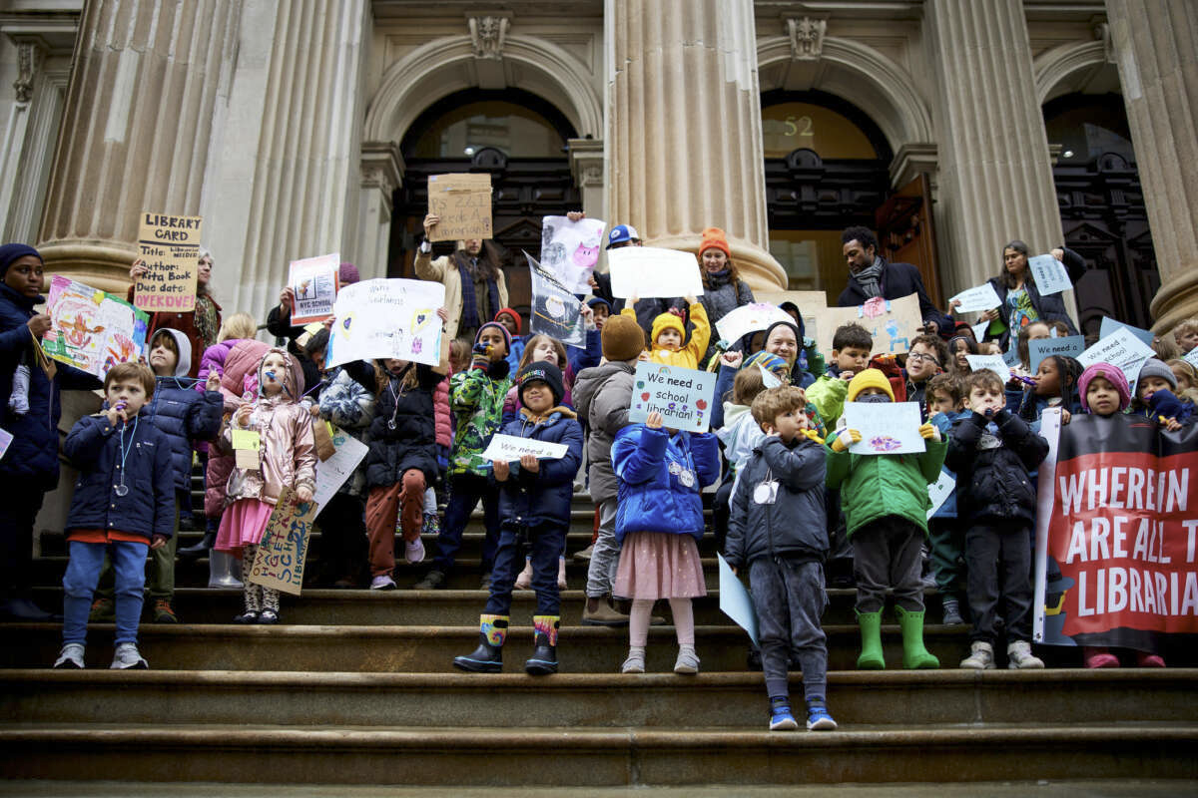
Students and Parents Are Fighting to Save NYC’s Imperiled School Libraries
New York City law requires every school to have a staffed library, but students are increasingly left without one.
By
  We need school librarians
  Emily Drabinski ,
  Truthout
  4 February 2023
Students rally on the steps of the New York City Department of Education, demanding a librarian for their school and all other NYC public school students.
Jeff Samaniego

Slide 48
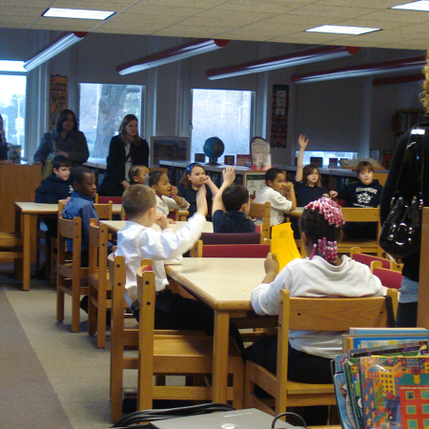
The pipeline of new librarians is a trickle
Teachers often pivot from the classroom to the library with little coursework or experience
Fewer programs educate school librarians—undergraduate or graduate. PA has 2 school library education programs--down from 6 ten years ago. Indiana has 1.

Slide 49
The long-term effects for school libraries
shortages of teachers and substitute teachers
librarians being used as subs and for other tasks
Fewer school librarians with school librarian education
How can we persuade potential school librarians to enter the profession given less professional work conditions and massive challenges to intellectual freedom?

Slide 50
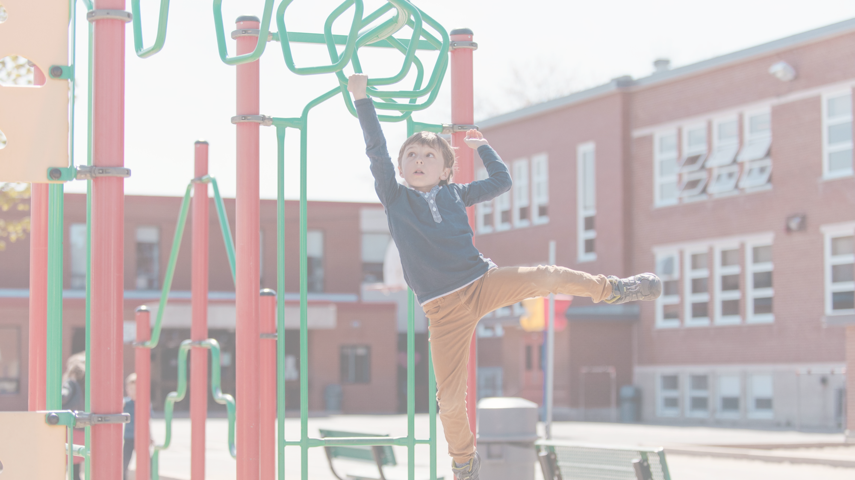
The way to get started is to quit talking and begin doing.
Walt Disney

Slide 51

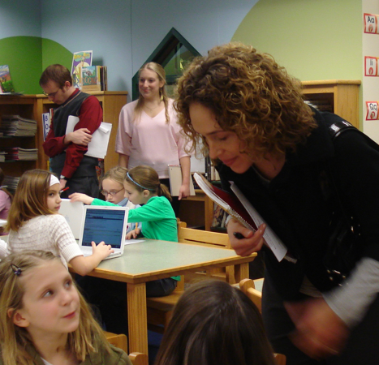
School librarians hold a strategic position
Because school librarians have knowledge of:
  All students
  All faculty
  School culture & curriculum
School librarians can lead from the middle

Slide 52

Take-Away Idea #1
Collaborate
Use your collaborative and pedagogical expertise
Demonstrate your unique value to achieving your school’s mission and goals
Lead from the middle

Slide 53

Add Value for Students
Provide reading guidance to raise student reading achievement
Encourage independent reading
Teach, coach, and model information literacy skills & digital citizenship
Advocate for students’ rights to information, and access to resources and technology
Coach individual and small-groups of students; volunteer with student organizations
Offer a safe learning space (makerspace/learning commons)

Slide 54

Add Value for Teachers
Partner with teachers to help them reach their instructional goals for their students and their own professional development
    Keep current on curriculum resources
    Offer professional development
    Collaborate in teaching and assessing student learning
    Emphasize information literacy skills
    Encourage their students to read
    Write grants for partnering with teachers

Slide 55

Add Value for Administrators
Help principals reach their objectives
    Keep current on pertinent info and resources
    Provide current awareness on issues
Offer professional development
Conduct research
Write grants

Slide 56

Take-Away Idea #2
Support Mission
Support your school district’s mission and initiatives and show how the school library program demonstrates the value the school librarian brings “to the table”

Slide 57
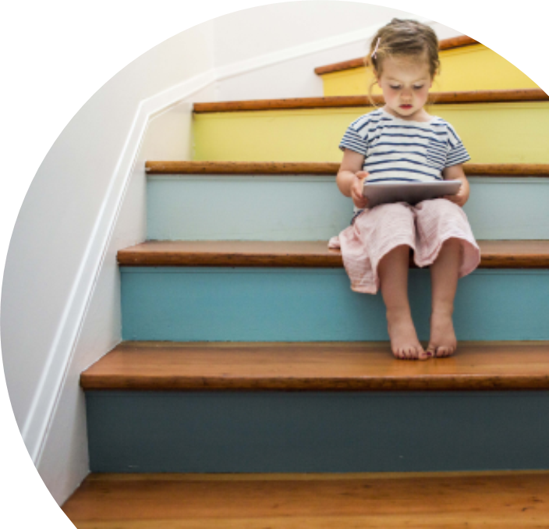
Don’t allow zip codes to determine which students have access to school libraries
Build support for school libraries at every level:
Building
District
Community
State
Federal

Slide 58
Protect the Constitutional rights of students to access information in school libraries
Extend liability protections to teachers and school librarians
Authorize $500 million in Comprehensive Literacy State Development Grants and $100 million for Innovative Approaches to Literacy Programs to help provide needed literacy resources and build strong and effective school libraries
Get on board—
support literacy Right to Read Act
Support Right to Read Act
https://www.ala.org/aasl/advocacy/right2read

Slide 59

Take-Away Idea #3
Tell with Data
Collect evidence of student success (data, artifacts, photos, video) to show the value the librarian brings in supporting the school’s mission and in achieving student progress

Slide 60
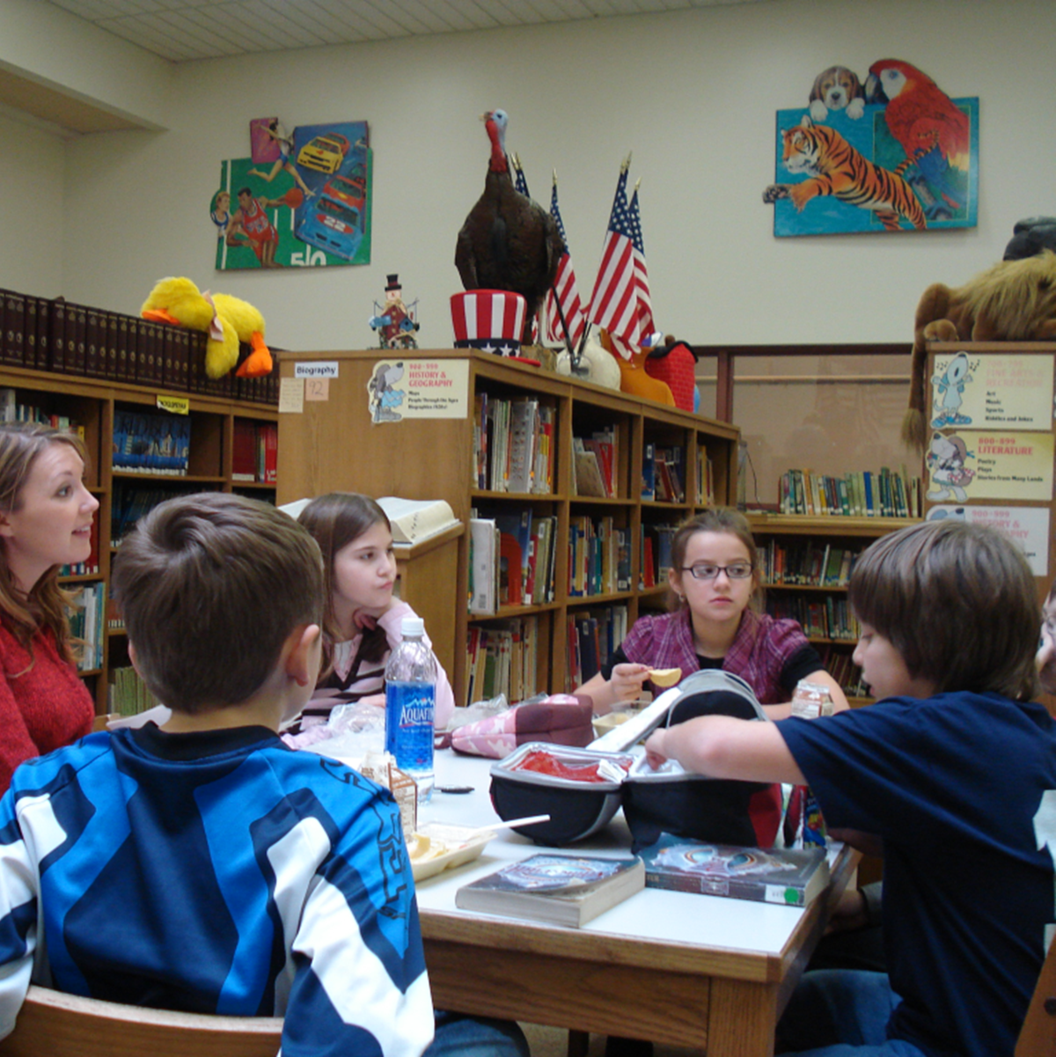
Listen to Students-- understand and advocate for their needs
In a time of fake news and information overload, students deserve access to a:
  School library
  School librarian
Students need access to information for learning and for life—give them access
Students learn critical thinking and empathy skills by reading–-let them read

Slide 61
Thank you!
Mary Kay Biagini
University of Pittsburgh
Biagini@pitt.edu
Please check out the SLIDE website
Interactive data tools for accessing user-specified data at state & district levels (step-by-step tutorials included)
  Custom Search
  District Comparison
  State Profile (including time-lapse map of districts)
  State Survey
  https://libslide.org

Slide 62

This project was made possible in part by the Institute of Museum and Library Services Laura Bush 21st Century Librarian Grant Project RE-246368-OLS-20. The views, findings, conclusions or recommendations expressed in this website and related products do not necessarily represent those of the Institute of Museum and Library Services.

