Slide 1
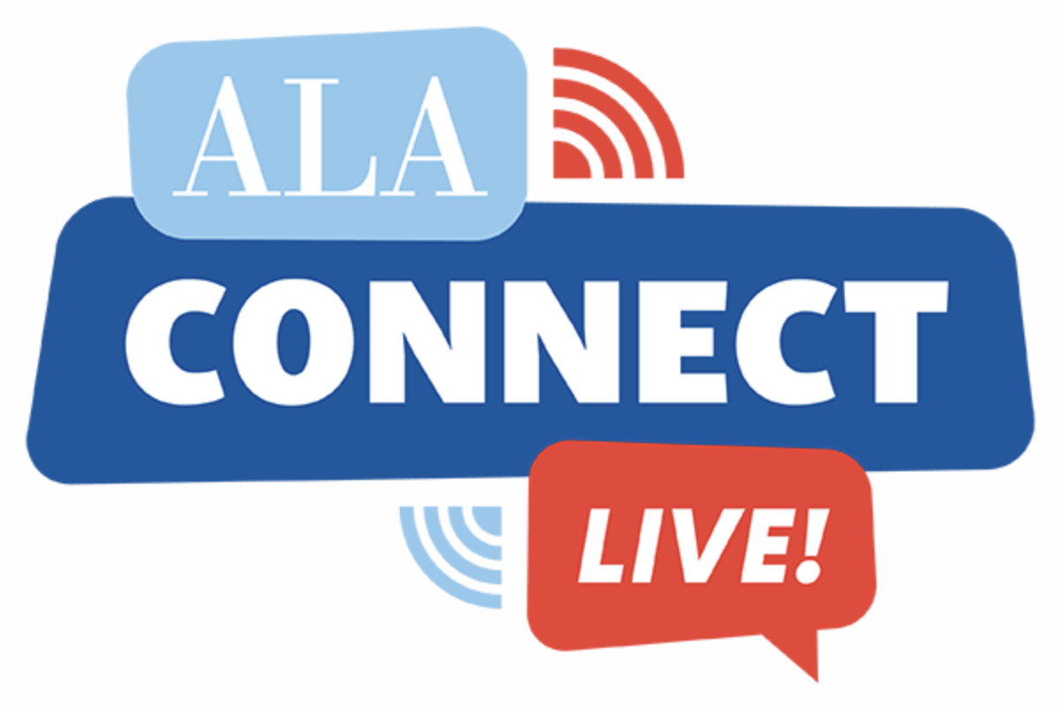
School Librarians: Status as of 2021-22
Keith Curry Lance
Principal Investigator
SLIDE: The School Librarian Investigation—Decline or Evolution?
libSLIDE.org – keithlance@comcast.net
Our Brave Communities: Embracing School Librarians

Slide 2
A Quick Review of Recent Trends & Patterns
National FTE trends
State differences in annual FTE change
Inequities in district ratio of librarians to schools
By locale
By enrollment
By poverty level
By race/ethnicity
Data on about 13K local districts from National Center for Education Statistics (NCES), Common Core of Data (CCD) Project

Slide 3
Nationwide, number of school librarians has been declining for more than a decade.
In 2019-20, COVID accelerated that trend … but losses slowed in 2020-21, and 2021-22 was 1st year in more than decade that number of school librarians increased.
Were some librarians temporarily reassigned? Did some librarians prove their worth during pandemic?

Slide 4
School librarian losses not universal.
Most years for more than a decade, 10-15 states gained librarians. Unfortunately, 3-4 times that many states lost
librarians.
COVID impact: 2020-21 saw record low number of states gaining and record high number of states losing. But, in 2021-22, there were record high number of gaining states and record low number of losing states.
What next?

Slide 5
.75+ FTE per school is the ratio SLIDE uses to determine if a district has enough librarians to have a full-time one in all or most schools. (Actual school staffing data on librarians are not available.)
Access to school librarians varies by locale.
Districts in suburbs & cities more likely to have librarians in all or most schools.
Districts in towns and rural areas more likely to have no librarians in any schools.

Slide 6
Access to school librarians varies by enrollment.
The larger a district’s enrollment the more likely it has librarians in all or most schools.
The smaller a district’s enrollment the more likely it has no librarians in any schools.
Overall, < 1/5 districts has librarians in all or most schools, and more than 1/3 have no librarians in any schools.

Slide 7
Access to school librarians varies by poverty status.
Districts in wealthiest communities most likely to have librarians in all or most schools.
Districts in poorer communities more likely not to have librarians in any schools.

Slide 8
While majority non-white districts equally unlikely to have librarians in most schools, they are slightly more likely not to have librarians in any schools.
Impact of majority race often ameliorated by locale (city) and enrollment (higher).
Majority Hispanic districts, however, are often smaller and rural ones, so fare dramatically worse than majority non-Hispanic ones:
Half as likely to have librarians in most schools, and far more likely not to have librarians in any schools.

Slide 9
Watch & Keep in Touch
Website for SLIDE: School Librarian Investigation—Decline or Evolution?
libSLIDE.org
Interactive data tools
Project & external publications
Conference presentations
News coverage of SLIDE (interviews, articles by others)
Debra Kachel, Antioch University Seattle
Project Director
dkachel@Antioch.edu
717-575-3886
Keith Curry Lance, RSL Research Group
Principal Investigator
keithlance@comcast.net
720-232-5866

